Slide 1

Parallel Computer Architecture
University of Thessaly
RISC-V
LOOP-STREAM DETECTOR
STAVROS STATHOUDAKIS 03512
KONSTANTINOS ANDRIKOPOULOS 03649
STAMOULIS SPYRIDON 03775

Slide 2
Design a stream loop detector
Project Objectives
Make it Synthesizable
Integrate it in the RISC-V project

Slide 3

The FSM
STAGE 1: TRACK
→ Job: Monitors the instruction stream.
→ Trigger: Detects a backward branch (B-type or JAL) with a negative immediate value that fits in our cache.
→ Action: Transitions to BUFFERING.

Slide 4
The FSM
STAGE 2: BUFFERING
→ Job: Writes each instruction of the loop body into the BRAM.
→ Important Check: If another branch or jump is found inside the loop, it's considered invalid. The FSM aborts and returns to TRACK.
→ Action: When the original branch is reached, transitions to WAIT

Slide 5
The FSM
STAGE 3: WAIT
→ Job: A single-cycle delay state.
→ Purpose: Prepares the BRAM to switch from write mode to read mode.
→ Action: Stalls the instruction fetcher and then transitions to REUSE

Slide 6
The FSM
STAGE 4: REUSE
→ Job: The main optimization state. Reads instructions from BRAM and feeds them to the pipeline.
→ Action: Blocks the normal instruction fetch stage.
→ Exit Condition: A branch mispredict signals the loop has finished, causing a transition back to TRACK.

Slide 7
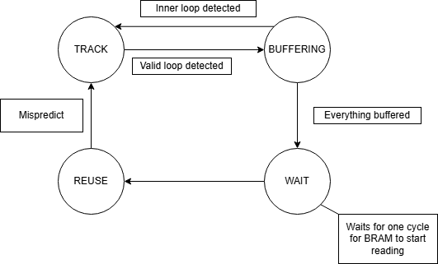
The FSM summarized

Slide 8

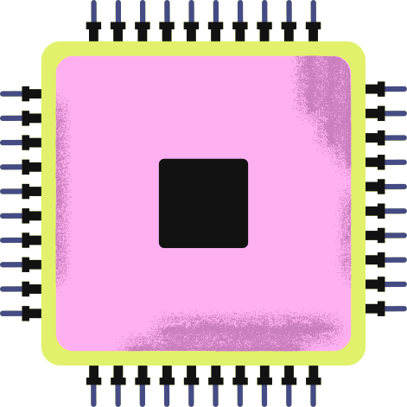
UOP CACHE
FSM
Responsible to source the later pipeline stages with stored small loops to be more cycle and power efficient
Implemented using one of Xilinx’s BRAMs.
BRAM

Slide 9
Reading
Writing
FSM
BRAM operating in SDP mode
Reading and writing using the correct bit and byte-wide enables
32-bit data split across 2 16-bits input and output ports
BRAM

Slide 10
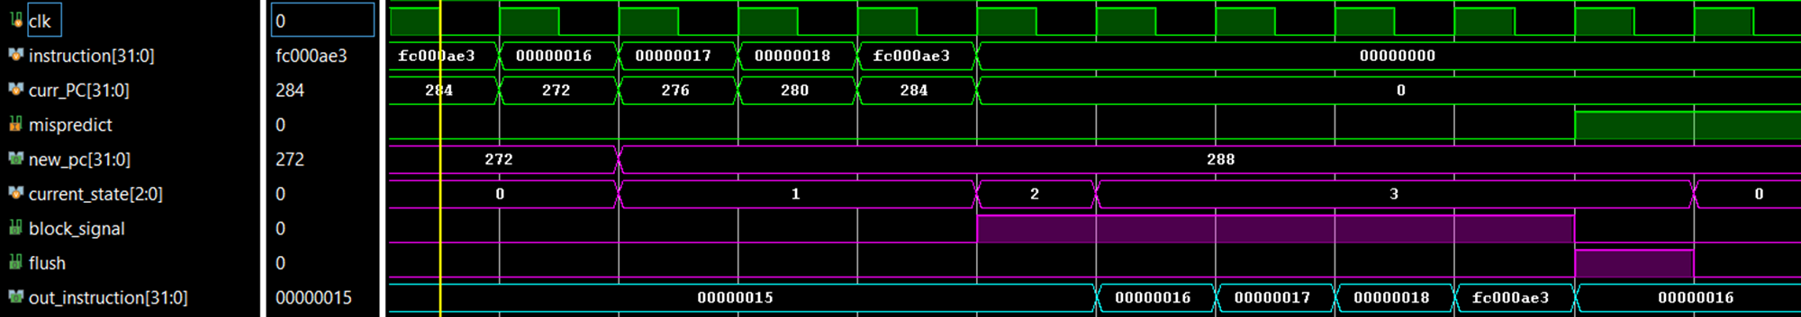
Post-Implementation Functional Simulation:

Slide 11
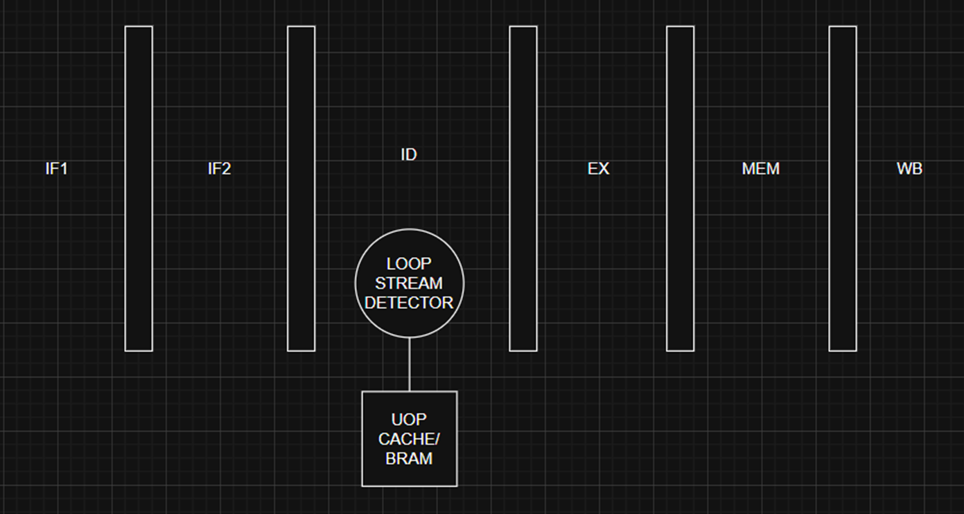
RISC-V

Slide 12
RISC-V Execution Codes
CASE 1:
Big Loop with 3 small subloops
CASE 2:
The Biggest Loop to test edge case
CASE 3:
One Instruction Loop to test edge cases
Link for writing assembly code

Slide 13
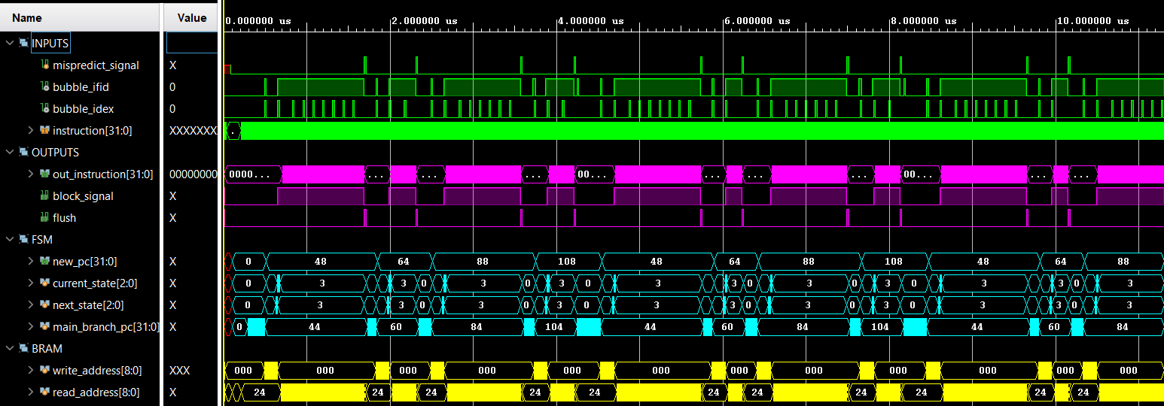
CASE 1

Slide 14
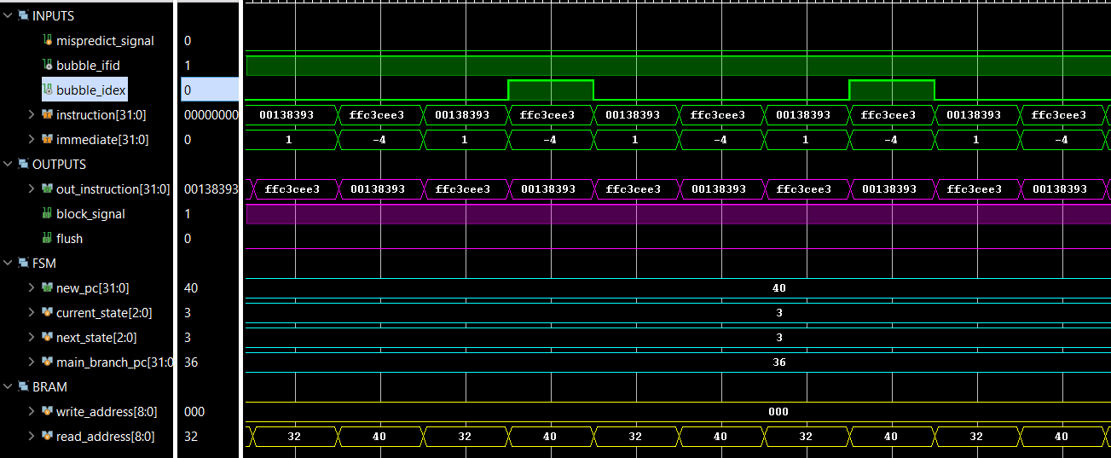
CASE 3

Slide 15
Fixing the reading from BRAM
4 extra Instructions
Because of branch misprediction and the flush that it produces we store 4 wrong instruction in the bram. To solve this we started reading from 4 instructions later. This way we start from the beggining of the loop.

Slide 16
Parallel Computer Architecture
University of Thessaly
THANK YOU FOR YOUR ATTENTION
ANY
QUESTIONS?
STAVROS STATHOUDAKIS 03512
KONSTANTINOS ANDRIKOPOULOS 03649
STAMOULIS SPYRIDON 03775

